Slide 1
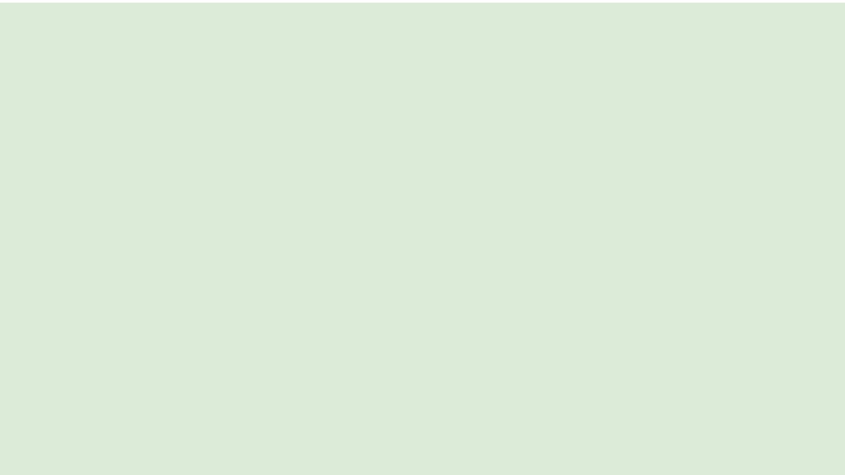

Fruit Rain
Teaching Coding with Fruit.
CHLOE VEDRINE | JUSTIN PORTILLO | DION DEL ROSARIO
SPRING 2023 GEORGIA GWINNETT COLLEGE

Slide 2
Agenda
Pre-survey
What is TAP?
Our mission
Meet the Team
Variables
Test what you've learned in Fruit Rain
Change the game code a little
What we hoped you learned
Post-survey
FRUIT RAIN

Slide 3

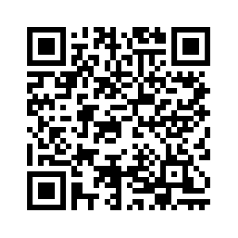
Pre Survey
Type in this link in the search box : https://ggc.az1.qualtrics.com/jfe/form/SV_a36sUt1QwTJt2Ga
Or use QR code:

Slide 4
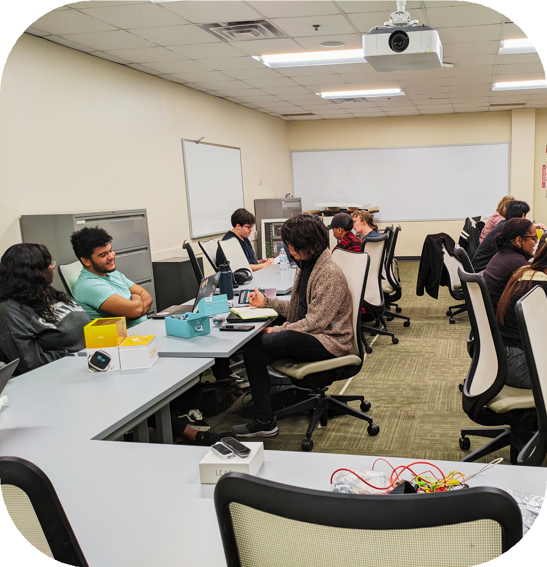
What is Tap?
TAP is a movement within the culture of technology at GGC that breaks down the stigmas surrounding technology. TAP, which stands for technology ambassador program, is a course at Georgia Gwinnett College that allows students to simulate real-world scenarios such as building projects, teamwork, leadership, and meeting project deadlines. The goal of Tap is to encourage students with varying levels of computer knowledge to demonstrate to others that technology is not as brash as it appears.
Anyone can take this class, regardless of major or experience in ITEC.
FRUIT RAIN

Slide 5
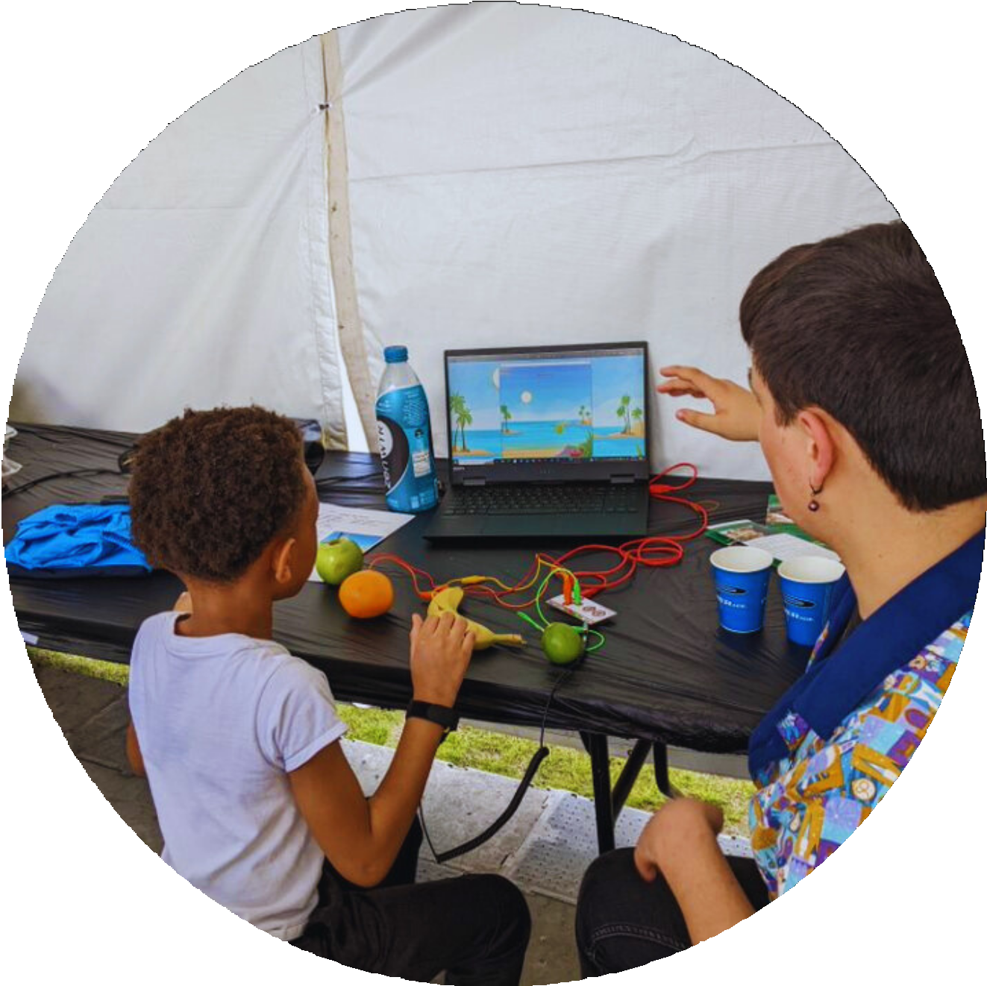
Our Mission
For our project, we wanted to find a way to teach others the basics of programming in a way that was fun, unique, and engaging.
The idea we settled on was to have players answer a variety of programming-related questions by touching the fruit.
We accomplished this with a Makey-Makey controller, with which we wired fruit to directional inputs.
Today, we'll be learning the concepts taught in the game, trying them for ourselves by writing some simple programs, and playing through the game to test what we've learned

Slide 6


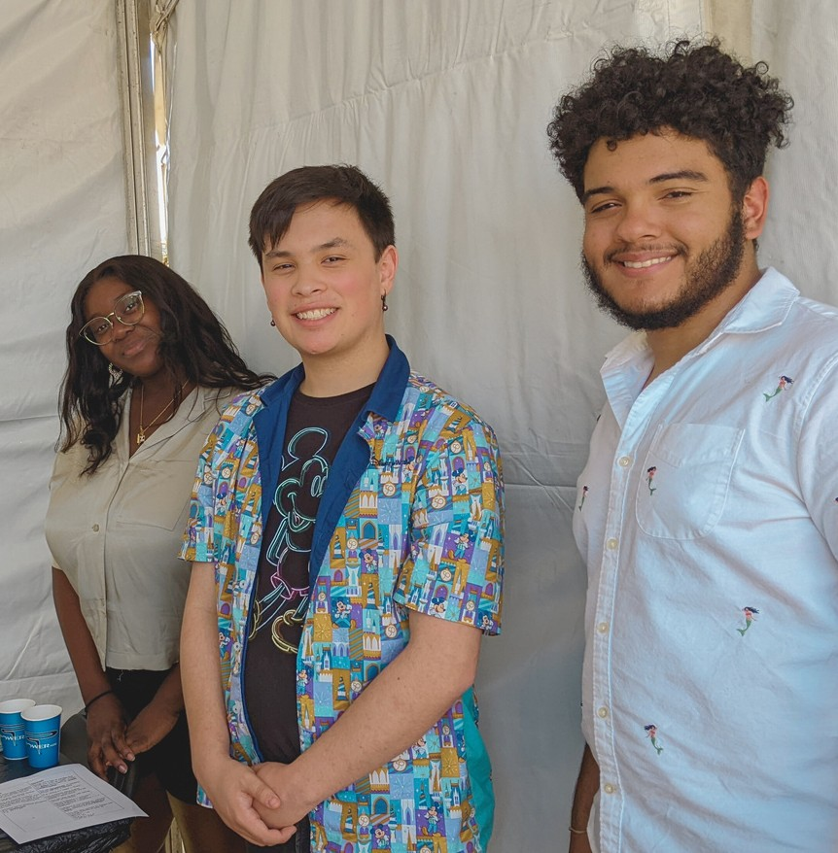
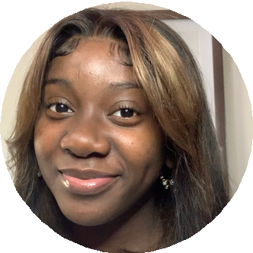


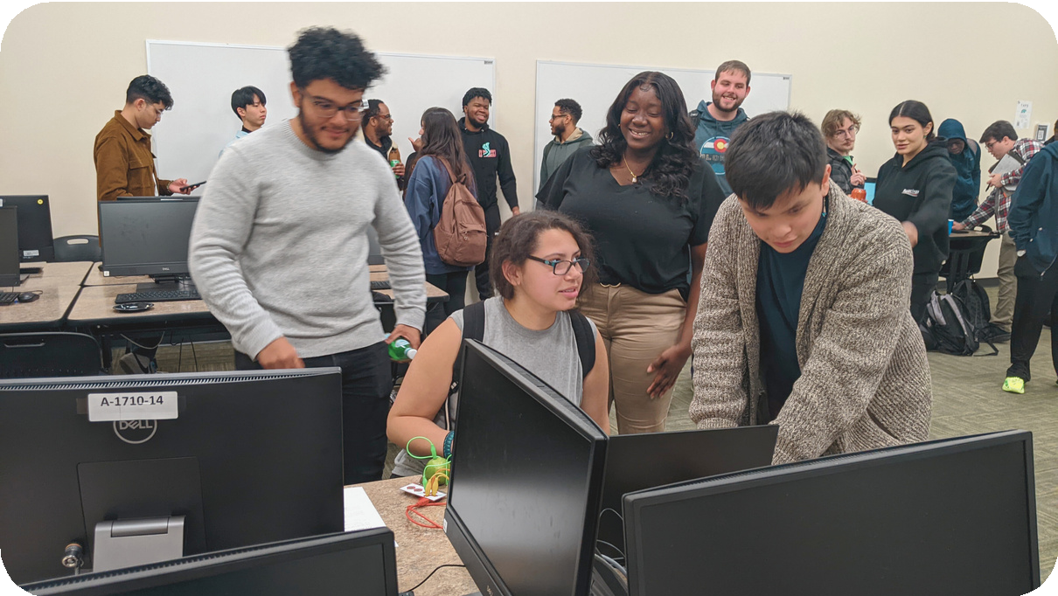
Meet The Team
Chloe Vedrine
-Systems and Security major
-Rising Junior
Justin Portillo
-Software Development major
-Rising Senior
Dion Del Rosario
-Systems and Security major
-Rising Senior
ATLANTA SCIENCE FESTIVAL | SPRING 2023

Slide 7
How To Access The Game
Type in: https://github.com/ChloeVed/FruitRain-Folder
OR: Google Drive Link/QR code, If you do not have a GitHub account, email the link to yourself (CAN'T play the game from phone)
https://drive.google.com/drive/folders/1O69y4RvU_GptOFblIeZL0kfKhPIEGogZ? usp=sharing
Notes:
Mention it needs to be pre-installed

Slide 8
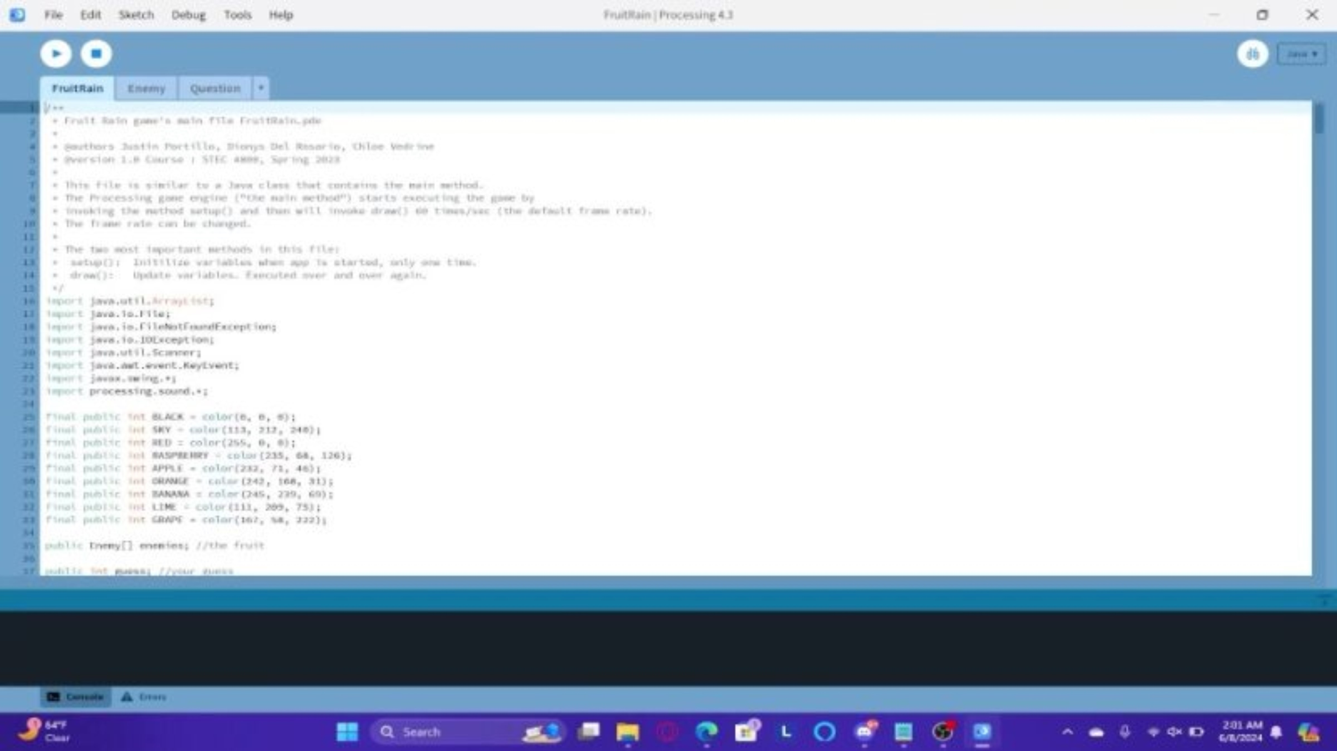
How To Access The Game
Notes:
Mention it needs to be pre-installed

Slide 9
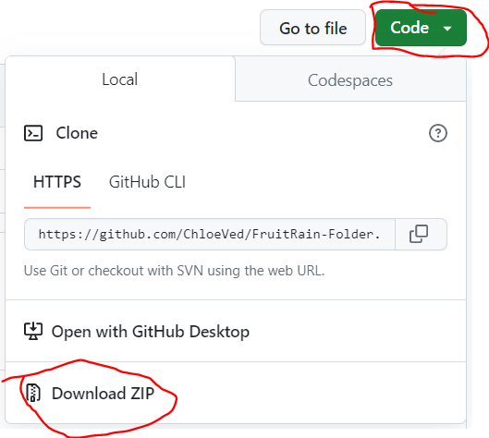
Step 1: Download The game
Once you've downloaded the ZIP folder, find it in your downloads and unzip it. Open it up.
Next, click on the folder named "FruitRain" (not to be confused with "FruitRain-Folder"), and look for the FruitRain processing file.
Open the file.

Slide 10
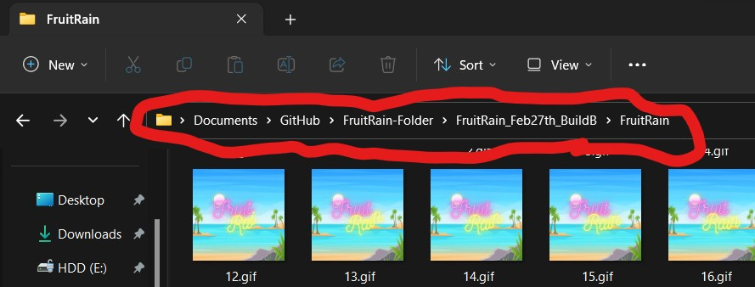
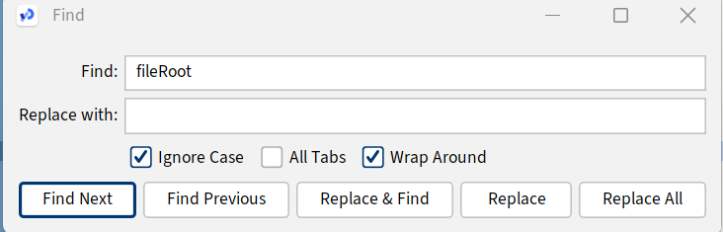
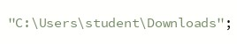
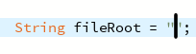
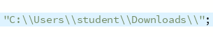
Step 2: Change the Filepath
In the FruitRain class, hit CTRL + F and enter "fileRoot"
Highlight the top of the address bar and hit CTRL + C
Add an extra "\" to the already existing "\"
Click in between the quotes and hit CTRL + V
Add "\\" at the end

Slide 11
Let's Start!
We'll focus on teaching variables
and operators today

Slide 12
First, what is a variable?
A variable is a way to store and manipulate data in a program.
Example: x = 1 means variable "x" stores "1" as its value.
You can name a variable anything and have it store almost anything.

Slide 13
First, what is a variable? cont.
String name = "Mark"; //text value
double price = 8.25; //decimal value
boolean isItRaining = false; //true or false (or any other binary)

Slide 14
First, what is a variable? cont.
There are different "types" of variables that allow you to store different things
When you make a variable you have to "declare" what type it's going to be (only need to declare it once)
Integer for whole numbers, String for text, Double for decimal numbers, and Boolean for true/false
You can store whole numbers into decimal variables, however
The Numbers will be displayed with a ".0" at the end

Slide 15
First, what is a variable? cont.
String name = "Mark"
double price = 8.25
boolean isItRaining = false
int x = 1

Slide 16
First, what is a variable? cont.
You can change what is stored in a variable by reassigning what it stores Example:
int x = 1
x = 5
Or
String name= "Mark"
name =

Slide 17
Arithmetic and Assignment Operators
Most arithmetic operators, such as +, -, *, and /, work the way you'd expect, adding, subtracting, multiplying, and dividing
Special operators of note include:
% : Modulus, which returns the division remainder (E.g. (int) 25/10 = 2, but 25%10 = 5)
++ : Increment, which increases the value of a variable by 1 (E.g. int x = 7; x++; // x = 8)
-- : Decrement, which decreases the value of a variable by 1 (E.g. int x = 7; x--; // x = 6)
An = sign is used to assign values to variables. Combinations of various other operators and the = work as shorthands for their expressions. (ie. +=, -=, *=, /=, etc)
e.g. x += 3 is the same as x = x + 3

Slide 18
Test what you have learned
Pull back up the game and press "down" to choose the Variables quiz. Read the questions carefully and take your time.
Finished? There are two other quizzes you're free to take. If you're interested in learning more about programming, go to https://www.w3schools.com/java/

Slide 19




How To Play:
Press the keyboard arrow key that corresponds with the fruit with the correct answer.
Bananas - Left Arrow Key
Lime - Right Arrow Key
Apples - Up Arrow Key
Oranges - Down Arrow Key

Slide 20
Let's apply what we've learned
Let's look at the game's code and change a few things

Slide 21
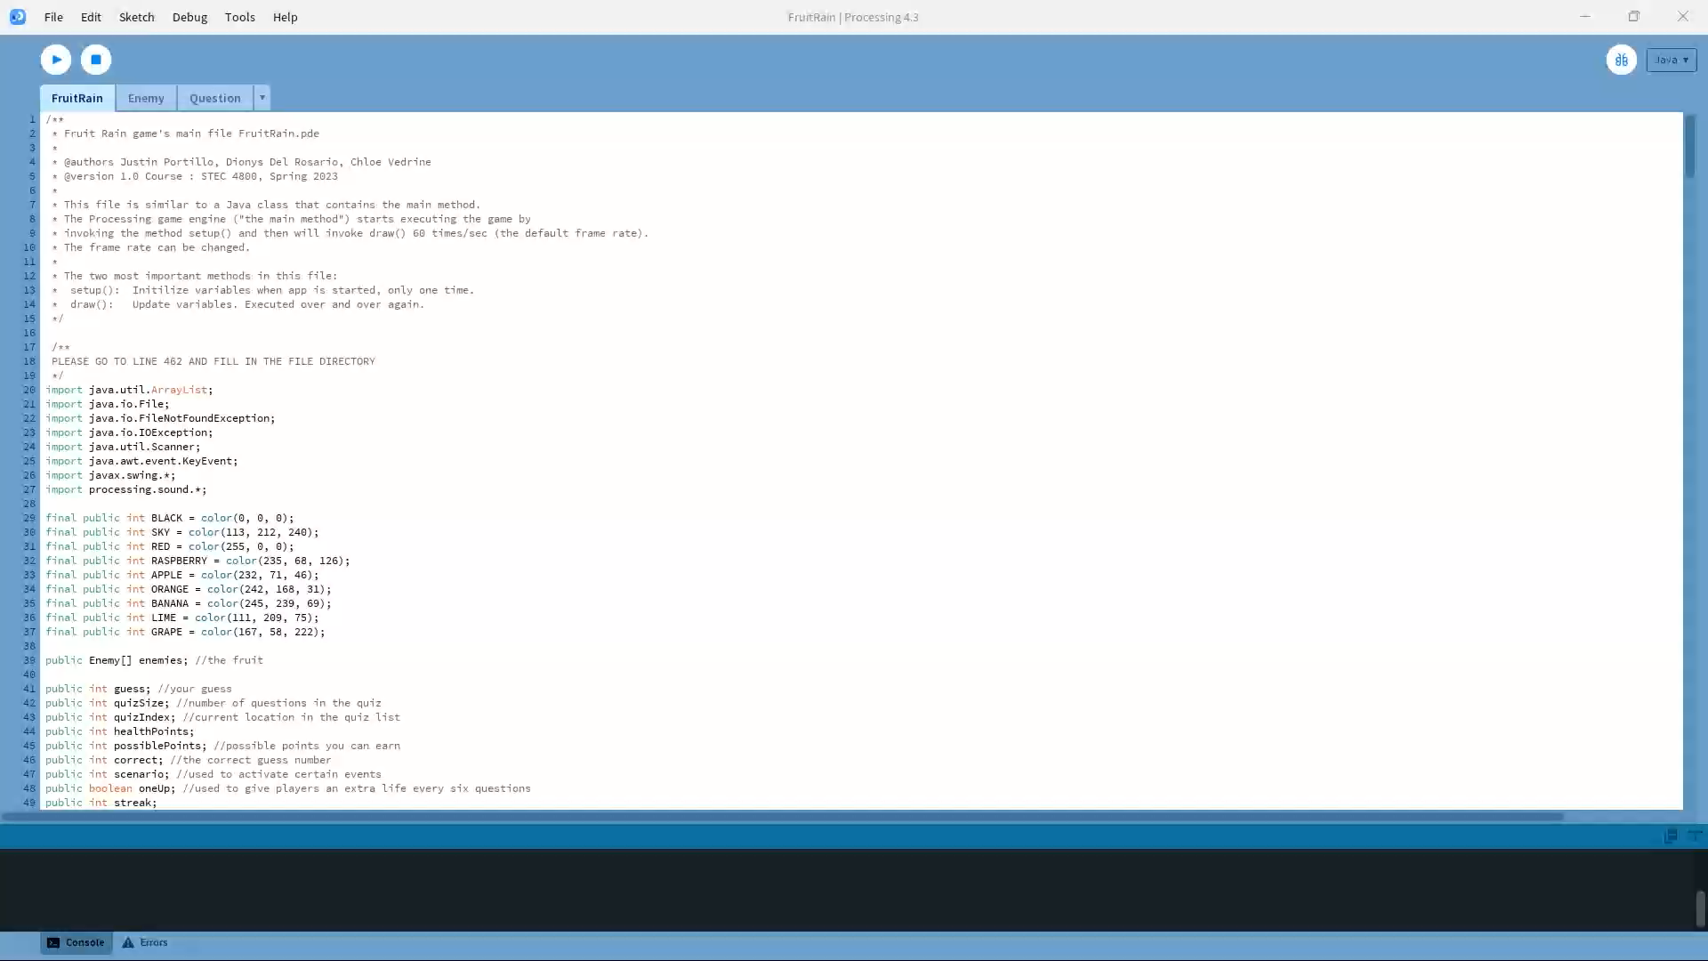
Let's apply what we've learned

Slide 22
What we hope you learned.
We hoped that by teaching you the fundamentals of coding, such as variables, you were able to get your foot in the door and see how much fun it can be. You now have a great story to tell when people ask you if you know how to code. You may inform them that you do! If you're interested in learning more about programming, your first step would be to take ITEC 2120 or ITEC 2140.

Slide 23
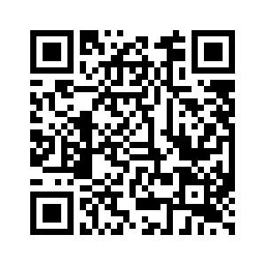
Post Survey
Another One!
Just a quick questionnaire to see if you've learned anything new.
Type in this link in the search box: https://ggc.az1.qualtrics.com/jfe/form/SV_86BeKF3h2msKTAy
Or use QR code:

Slide 24
Thank you!
CHLOE VEDRINE | JUSTIN PORTILLO | DION DEL ROSARIO
SPRING 2023 GEORGIA GWINNETT COLLEGE

